Slide 1
Military Scenario Definition Language (MSDL): How Broadly Can It Be Applied?
Paper 08S-SIW-002
Spring SIW
15 April 2007
Curtis Blais
NPS MOVES Institute
clblais@nps.edu

Slide 2
Background
The US Army TRADOC (Training and Doctrine Command) Analysis Center, Monterey (TRAC-Monterey) is developing a number of tools to assist analysts in working with various simulations, initially Pythagoras and Infantry Warrior Simulation (IWARS):
  Microsoft Access data base for storing scenario elements (force structures, weapon parameters, sensor parameters)
  Web-based user interface for designing experiments and initiating model execution on computing clusters
  Graphical User Interface for constructing scenarios (forces, force capabilities, gamespace, initial placements, initial behaviors)

Slide 3
Premise
The Military Scenario Definition Language (MSDL) can be used to provide a common representation of scenario information that can be employed by many different simulations.
How about for Agent-Based Simulations
like Pythagoras, IWARS, MANA, etc.?

Slide 4
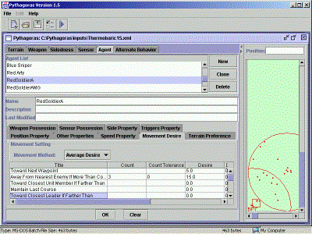
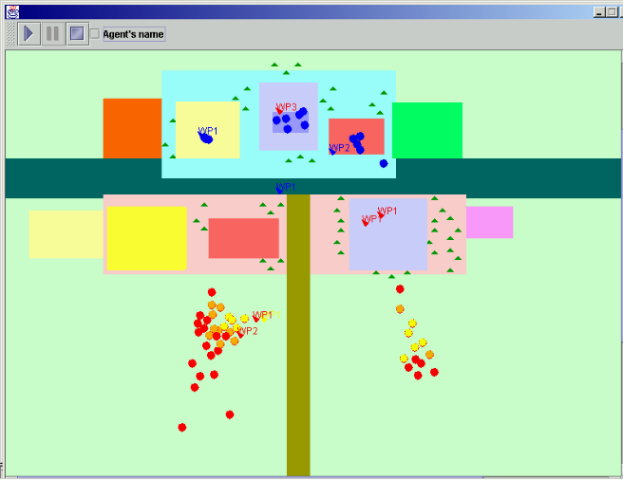
Agent Based Simulation
Individual decision-making based on local conditions
  Heterogeneous entities
  Perform actions, such as:
    Move
    Shoot
    Sense
    Order
    Communicate
Example: Pythagoras

Slide 5
Pythagoras Overview
Terrain Features
  - Mobility - Protection
  - Height - Concealment
Agent Decisions
  - Soft decision rules
Dynamic Affiliation
  - Same Unit - Same Side
  - Enemy - Neutral
Sensors (multiple “bands”)
Comms (multiple “channels”)
Weapons
  - Lethal - Non-Lethal
Triggers: Change behavior rules when triggered
Measures Of Effectiveness
MOE
Engine
MOE
Engine
Output
Output
Action
Scenario
Movement
Scenario
Outcomes
Output
Legend
Legend
XML File
XML File
GUI
GUI
JAVA Software
JAVA Software
Text File
Text File
Notes:
Blue denotes attributes unique to Pythagoras.

Slide 6
Pythagoras Agents
Affiliation (Shades (0-255) of Red, Green, Blue)
Attributes (Alpha, Beta, Gamma (0-1000))
Height and Altitude
Speed, Speed Variability
Detectability (Multiplier on Sensor Detection)
Vulnerability (Multiplier on Weapon Pk)
Color Vulnerability (Multiplier on Paint Balls)
Attribute Vulnerability (Multiplier on Weapons Affecting Attributes)
My Leadership (Leader If At Least 1 Point Greater)
Obedience
Movement Selection Mode (Mode 1, 2, 3 or 4)
Has Weapon Type (Up to Three)
Marksmanship
Has Sensor Type (Up to Three)
Has Comm Type (Up to Three)
Italics Indicate Possible Soft Decision Rule Variables

Slide 7
Pythagoras Agents (cont’d)
Comm Effectiveness
Next Way Point
Way Point Proximity (How Close Is Close Enough)
Target Value
Hold-Fire Desire
Target Persistence
Fuel Tank Capacity, Fuel Initial Load, Usage per Step
Resource X,Y,Z Tank Capacity, Resource X,Y,Z Initial Load, Usage per Step
Knowledge Retention
Italics Indicate Possible Soft Decision Rule Variables

Slide 8
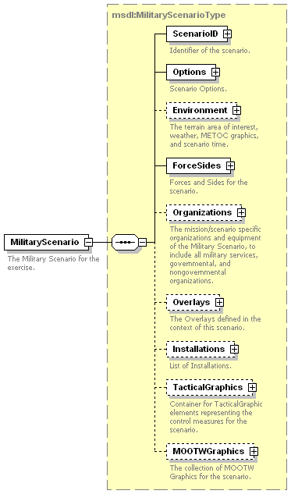
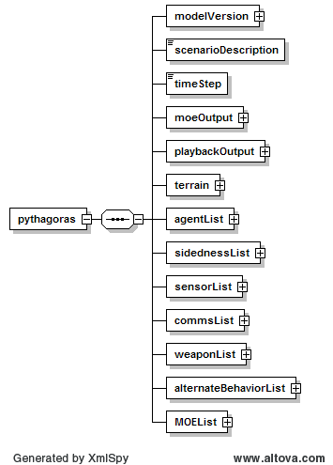
Schema Comparison
MSDL v1.0
Pythagoras v1.10.5
Notes:
Initially interested in transformation from Pythagoras scenario description to MSDL. To create a valid MSDL file, have to be concerned with required information in the MSDL document structure. Second, is to capture as much Pythagoras data as possible while preserving the validity of the MSDL document.

Slide 9
Approach
1. Achieve as much as possible through automated XML transformation (XSLT)
2. Identify Pythagoras content that can be transferred into MSDL structures
  Address required MSDL elements first (if something is required in MSDL, see what can provide that information from Pythagoras)
  Then fill optional MSDL elements as applicable
  Try to maintain MSDL document validity against its XML schema
  Address any shortcomings with valid “fillers”

Slide 10
Approach (cont’d)
3. Strategize how to transfer/store remaining Pythagoras information
  xs:any portion of modelIdentificationType
  ( http://www.sisostds.org/schemas/modelID namespace)
  Combine MSDL and Pythagoras content into a hybrid XML document (with a governing schema employing both namespaces) and use XSLT to generate a strict MSDL or a strict Pythagoras file from the combined file
4. Identify issues to be addressed through specialized software logic or human decision

Slide 11
XSLT Document
<?xml version="1.0" encoding="UTF-8"?>
<xsl:stylesheet version="2.0" xmlns:xsl="http://www.w3.org/1999/XSL/Transform" xmlns:xs="http://www.w3.org/2001/XMLSchema" xmlns:xsi="http://www.w3.org/2001/XMLSchema-instance" xmlns:fn="http://www.w3.org/2005/xpath-functions">
<xsl:output method="xml" version="1.0" encoding="UTF-8" indent="yes"/>
<xsl:template match="/">
<xsl:element name="MilitaryScenario">
<xsl:attribute name="xsi:schemaLocation">urn:sisostds:scenario:military:data:draft:msdl:1 H:/projects/SISO/MSDL/Specifications/ReadyForSACAug2007/READYF~1/draft/msdl/V_1.0/MilitaryScenario_1.0.0.xsd
</xsl:attribute>
<msdl:ScenarioID>
<modelID:name>Pythagoras</modelID:name>
<modelID:type>Pythagoras</modelID:type>
<modelID:version>
<xsl:value-of select="pythagoras/modelVersion/major"/>.
<xsl:value-of select="pythagoras/modelVersion/minor"/>.
<xsl:value-of select="pythagoras/modelVersion/bugFix"/>
</modelID:version>
<modelID:modificationDate>2008-01-01</modelID:modificationDate>
<modelID:securityClassification>Unclassified
</modelID:securityClassification>
<modelID:description>
<xsl:value-of select="pythagoras/scenarioDescription"/>
</modelID:description>
. . .
Documents the mappings and conversions

Slide 12
Some of the Findings
Can capture the identity of Pythagoras agents as units or equipment in MSDL
  Conceptual disconnects in notion of side and possession of equipment
No artificial coordinate system in MSDL to align with pixel-based or other artificial coordinates such as used in Pythagoras
No way to indicate scaling information for distance, time, and speed (not available in Pythagoras XML either)

Slide 13
Some of the Findings (continued)
No automatic way to identify particular terrain areas in Pythagoras as “buildings” for capture as MSDL Installations
No capture of Pythagoras weapon or sensor characteristics in MSDL
No capture of Pythagoras agent behavior settings in MSDL

Slide 14
Conclusions
MSDL has promise for broad application, but several issues need to be discussed in the community
  Perhaps a “core” MSDL with collections of extensions as “profiles”
As the MSDL becomes an approved standard, more designers/developers should do similar investigations of mappings to and from MSDL for their systems
  Provides inputs/insights into best practices for scenario data interchange using MSDL
  Provides information about other capabilities for consideration in future versions of the standard

Slide 15
Status
Initial Pythagoras-to-MSDL XSLT completed
  Note: The reverse, MSDL to Pythagoras, is a harder question. What constitutes a “generic” MSDL file? Seems to depend on the source simulation system. Does any system fill all elements in the MSDL structure?
Follow-on effort starting up: Redesigning scenario development GUI to use MSDL as its base schema, with capability to import and export Pythagoras, IWARS, and COMBAT^{XXI} files.
Notes:
Re the note. A Pythagoras source file is always what it is, with certain required and optional elements. An MSDL file, in contrast, has different characteristics depending on what originated it; i.e., here is an MSDL file generated by OneSAF, here is an MSDL file generated from Pythagoras, etc. They will have certain fundamental differences based on the source data model.

Slide 16
Questions?
For more information:
Curtis Blais
MOVES Institute
Naval Postgraduate School
831-656-3215
clblais@nps.edu

